Slide 1
Database Connectivity & 3rd Party Libraries
Dr. Jeff Hill

Slide 2
Code libraries
To this point, we’ve stuck with using the standard library
This changes with each new Java version
New things are added
Old things are removed
Some things are deprecated
Java has been around for decades
Tons of Java programmers have created billions and billions of lines of code
The whole purpose of object oriented programming is to foster code reusability
It would be wonderful if we could use other programmer’s code easily
Copy & paste works, but often takes some intricate and tedious modifications

Slide 3
Java archive files
Java has its own file format for sharing code libraries
“jar file” – uses a .jar file extension
Uses .zip compression internally
Intended for bytecode distribution although you can include source code if you wish
2 main types:
JAR File – for usage as a library for other programs
Executable JAR File – for usage as a runnable program
Packaged based upon a Project
We can select which packages & classes to include/exclude
We’ll learn to create our own next class, for now, we’ll use other people’s

Slide 4
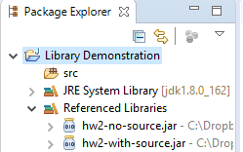
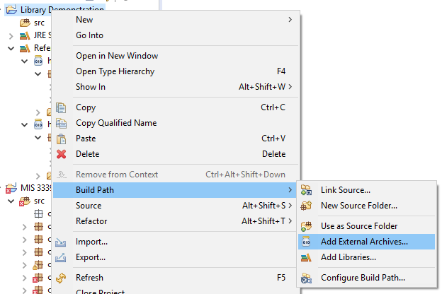
Using JAR files
Linked files appear here
JAR files must be added to the classpath of a project to be usable
Classpath basically provides a listing of libraries that Java can use to find referenced classes
Can include the Java Standard Library, 3rd party APIs, projects that you create, etc.
Generally kept inside a “lib” folder in the Project’s folder
JAR files are linked to a Java Project
If you are working with multiple projects, then you must link each as appropriate
You can add as many JAR files as you need

Slide 5
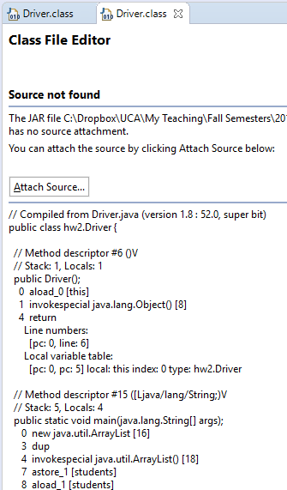
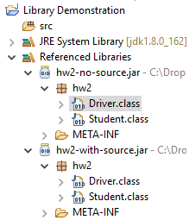
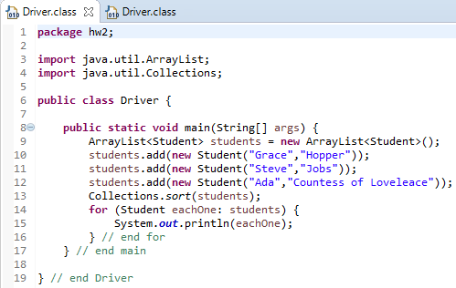
Inside a JAR file
We can see the content of JAR files by expanding their contents in the “Package Explorer” pane
JAR files can include source code, or not, as the library’s creator packages it…
They are always listed with the .class extensions even if source code is included
Just double-click on a .class to see details

Slide 6
3rd party libraries
All kinds of JAR file libraries exist, for all kinds of needs
We’ll look at using one distributed by Oracle to connect to a database server
Filename is called “ojdbc7.jar”
Current version for use with Oracle 12c and earlier database engines
New one generally released with major version server releases
Remember: must be added to the Java Project’s classpath via previously demonstrated process

Slide 7
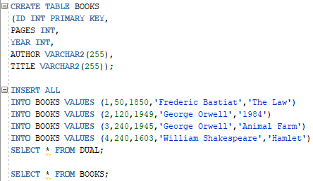
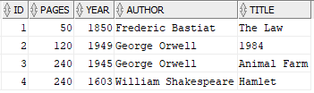
TANSTAAFL
Just because they give us a library to help us do something…
Doesn’t mean it will be easy to use
This is relatively simple in a native SQL tool such as SQLDeveloper

Slide 8
JDBC
These database driver libraries work with an API called Java Database Connectivity (JDBC)
Defines a standard interface (API) for programming an application with any JDBC compliant database engine
Must provide a JDBC compliant driver API file as well!
ResultSet ← these are the results of a query
ResultSetMetaData ← this is the metadata for a query
PreparedStatements ← this helps us avoid SQL injection attacks

Slide 9

SQL injection
Database applications are all about entering, querying, and manipulating data
This simplest way of creating a SQL query from a form is to use regular old string concatenation
THIS IS WRONG, NEVER, NEVER, NEVER DO THIS!
Given the above HTML form data entry we could programmatically generate a SQL query string something like this:
String SQL = “SELECT * FROM STUDENTS WHERE FNAME = ‘” + fName.getText() + “’ AND LNAME = ‘” + lName.getText() + ‘”;
This would result in this case in the following SQL query string
SELECT * FROM STUDENTS WHERE FNAME = ‘Jeff’ AND LNAME = ‘Hill’;
This works, so what is the problem?

Slide 10

SQL injection
If a malicious user instead types in valid SQL code
The above ends up as…
SELECT * FROM STUDENTS WHERE FNAME = ‘Jeff’ AND LNAME = ‘’;DROP TABLE STUDENTS;
2 completely valid SQL commands
Both will be executed as written
1st returns an empty record set as there likely are no matches
2nd drops the table from the database
Modern database engines have between no and a lot of built-in protection against SQL injection attacks
Never trust to built-in protections, instead always practice defensive coding
Intended to ensure the continuing function of a piece of software under unforeseen circumstances (Wikipedia, 2018)

Slide 11

Parameterized queries
https://xkcd.com/327/
Allows the database engine to perform the string concatenation
Never the programming language
We craft a SQL query statement with placeholder character(s)
Pass this along with replacement(s) for the placeholder(s)
These are the actual data values
Database engine will safely concatenate data, even SQL injection strings
In the prior examples – the SQL injection string of ’;DROP TABLE STUDENTS; would be saved into the last name field instead of being executed
This is only one style of SQL injection attack, there are others
Never, never, never trust user entered data!

Slide 12
On to the SQL…
Now that we know about:
3rd party libraries
Oracle’s ojdbc7.jar
Known as the thin driver in contrast to other “fatter” drivers (e.g. JDBC-ODBC bridge)
JDBC
ResultSet, ResultSetMetaData, PreparedStatements
PreparedStatements are Java’s method of implementing parameterized queries
Defensive programming
Parameterized queries and SQL injection
Today’s examples won’t include this
The wrapper I provided does use the Java’s PreparedStatement class
I’ll show you how to use this in later classes
We’re ready for a simple SQL example…

Slide 13
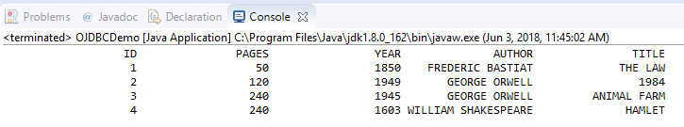
“Simple” JODBC example
package class19;
import java.sql.Connection;
import java.sql.DriverManager;
import java.sql.ResultSet;
import java.sql.ResultSetMetaData;
import java.sql.SQLException;
import java.sql.Statement;
public class OJDBCDemo {
public static void main(String[] args) {
try {
// load the Oracle driver into the JDBC driver manager
// "oracle.jdbc.OracleDriver" is the name that must be used
// there is an older reference oracle.jdbc.driver.OracleDriver that is now deprecated
Class.forName("oracle.jdbc.OracleDriver");
} // end try
catch (ClassNotFoundException ex) {
System.out.println("The Oracle driver is not available.");
System.out.println(ex.getMessage());
} // end catch
// conn must be defined here so that is "in scope" for the finally block
// this allows us to defer .close() all the way until then
Connection conn = null;
// JDBC database operations require exception handling (throw SQLException)
try {
// create a connection to the local Oracle database using the jdbc
// API and the Oracle driver/wrapper
// create conn once and pass it to all following method invocations as an argument
// this allows us to define the endpoint one time for the entire application and then
// only have to change it in one place if necessary
// the following is a connection string for UCA's Oracle server
conn = DriverManager.getConnection("jdbc:oracle:thin:@161.31.3.67:1521:xe","MIS3339","MIS3339");
// explicitly set transactional processing to be off
conn.setAutoCommit(true);
Statement stmt = conn.createStatement();
ResultSet rs = stmt.executeQuery("SELECT * FROM BOOKS");
// get the table's metadata
ResultSetMetaData md = rs.getMetaData();
// databases start counting at 1, not 0 like arrays
for (int i = 1; i <= md.getColumnCount(); i++) {
System.out.print(String.format("%1$"+20+ "s", md.getColumnName(i).toUpperCase()));
} // end for
// insert a CR/LF after all the column names are printed out
System.out.print("\n");
// iterate through the rowset
while (rs.next()) {
// iterate through the columns in each row
for (int i = 1; i <= md.getColumnCount(); i++) {
System.out.print(String.format("%1$"+20+ "s", rs.getObject(i)).toUpperCase());
} // end for
System.out.print("\n");
}// end while
System.out.println(""); // enter a blank line after outputting the db contents
stmt.close(); // close the Statement
rs.close(); // close the ResultSet
conn.close(); // close the Connection
} catch (SQLException e) {
System.out.println(e.getMessage());
e.printStackTrace();
} // end catch
} // end main
} // end OJDBCDemo
Um… yeah…
This is where senior programmers can assist junior programmers by creating wrappers
Hides complexity
Enhances usability

Slide 14
Wrapper JODBC example
Same result
Much simpler code
I take care of the connection
You take care of the SQL and how to output it
package class19;
import java.sql.ResultSet;
import java.sql.ResultSetMetaData;
import java.sql.SQLException;
import uca.mis3339.OracleWrapper;
public class UCAWrapperDemo {
public static void main(String[] args) {
try {
OracleWrapper.prepareStatement("SELECT * FROM BOOKS");
ResultSet rs = OracleWrapper.queryDB();
ResultSetMetaData md = rs.getMetaData();
// databases start counting at 1, not 0 like arrays
for (int i = 1; i <= md.getColumnCount(); i++) {
System.out.print(String.format("%1$"+20+ "s", md.getColumnName(i)).toUpperCase());
} // end for
// insert a CR/LF after all the column names are printed out
System.out.print("\n");
// iterate through the rowset
while (rs.next()) {
// iterate through the columns in each row
for (int i = 1; i <= md.getColumnCount(); i++) {
System.out.print(String.format("%1$"+20+ "s", rs.getObject(i)).toUpperCase());
} // end for
System.out.print("\n");
} // end while
rs.close();
} catch (SQLException e) {
System.out.println(e.getMessage());
} // end catch
} // end main
} // end UCAWrapperDemo
Makes use of 2 .jar files:
ojdbc7.jar
uca-database-wrapper.jar

Slide 15
Assuming metadata wrapper example
Makes use of 2 .jar files:
ojdbc7.jar
uca-database-wrapper.jar
package class19;
import java.sql.ResultSet;
import java.sql.SQLException;
import uca.mis3339.OracleWrapper;
public class RealWorldWrapperDemo {
private static int PADDING = 20;
public static String formatMe(String inc) {
return String.format("%1$"+ PADDING + "s", inc).toUpperCase();
} // end formatMe
public static void main(String[] args) {
try {
String header = "";
header += formatMe("ID");
header += formatMe("PAGES");
header += formatMe("YEAR");
header += formatMe("AUTHOR");
header += formatMe("TITLE");
OracleWrapper.prepareStatement("SELECT * FROM BOOKS");
System.out.println(header);
ResultSet rs = OracleWrapper.queryDB();
// iterate through the results
while (rs.next()) {
String record = "";
// don't forget, databases start counting at 1
record += formatMe(String.valueOf(rs.getObject(1)));
record += formatMe(String.valueOf(rs.getObject(2)));
record += formatMe(String.valueOf(rs.getObject(3)));
record += formatMe(String.valueOf(rs.getObject(4)));
record += formatMe(String.valueOf(rs.getObject(5)));
System.out.println(record);
} // end while
rs.close();
} catch (SQLException e) {
System.out.println(e.getMessage());
} // end catch
} // end main
} // end RealWorldWrapperDemo
Many times we don’t care about metadata
We already know the database’s structure
We made it!
Just create the query
Execute
Parse the results
Must update the program if the database structure changes
Most of the time, this is OK

Slide 16
Questions?

